Slide 1




Your Homebuyer Journey
PRESENTED IN PARTNERSHIP WITH:
Insert Company Logo Here
07/31/2026
Notes:
This homebuyer presentation is for you to use to educate your homebuyers. Before presenting you must brand this presentation. Below are highlights as to what branding content you will need. Good luck!!
Slide 2: Insert your name and add a few pictures of you and or what is important to you. Do you have any photos of successful homebuyers?
Slide 3: Add your photo, NMLS# and your contact info. Don’t forget to add any accomplishments or designations. Top NH Housing lender???
Slide 38: Add your photo and contact information, NMLS#

Slide 2






Welcome
Name
Title
Company
Tel:
Email:
Insert Headshot
Ryan Tufts
NMLS# 1639731
Tel: (603) 521-2160
Email: rtufts@TryNorthpoint.com
Notes:
Add your photo, NMLS# and your contact info. Don’t forget to add any accomplishments or designations. Top NH Housing lender???
Talking Points
Welcome, everyone! I’m thrilled you’re here, ready to learn about buying your first home. By joining today, you’re already taking an important step toward achieving the dream of homeownership! Together, we’ll explore how to build a strong financial foundation and shape the future you’ve always envisioned.
Introduce yourself. Include your Value Proposition, areas of town you specialize in, and even something personal about you / your team, for example, awards, charities, family, pets, hobbies, etc.
Talking Points
Let me tell you a little about myself.
My name is …
I’m with …
I’ve been doing this since …
and I have helped xx families buy their first home.
My passion is helping you get what you need when you need it!
I’m here to answer all your questions, so let’s dive in and get started on this exciting journey!

Slide 3
What’s one thing you want to learn today about buying a home?
Notes:
Ask participants to type their questions into the chat box.
Talking Points
You’re here today to get your questions answered, and I’m here to help! Is there something specific you’d like to know more about? Drop your question in the chat, and let’s dive into what matters most to you!

Slide 4
What We Will Cover
Assessing Your Readiness
Build Your Team
Applying for a Mortgage and New Hampshire Housing
Finding Your Home and the Closing Process
Questions
Notes:
Talking Points
Thank you for sharing your questions! We’ll dive into these topics and much more, covering the key areas that will help address your concerns. Let’s make sure you leave today feeling confident about your homebuying journey!
Today we will be covering the following:
Assessing your readiness for Homeownership
Your Homebuying Team
Applying for a mortgage and New Hampshire Housing Mortgage Programs
Finding your Home and the Closing Process
Questions

Slide 5
Assessing Your Readiness
How do you know when you are ready to buy a home?
Notes:
How do you know when you are ready to buy a home?

Slide 6

Common Homebuying Question
When is the best time to buy?
The best time to buy is when you are ready!
Notes:
Talking Points
Review some common myths about homebuying.
Ask if there are other myths you need to address? Have them put their questions into the chat.
Talk about other myths

Slide 7

Steps to Homeownership
  Assess your readiness
  Meet with a lender
  Build your team
  Find your home
  Get a home inspection
  Closing
Notes:
Talking Points
Review the Steps to homeownership.
Ask where people are in their journey.
Have them put it into the chat.

Slide 8
Indicators of Readiness
Income: Do you have steady income and employment?
Savings: Expect a minimum of 6% to cover downpayment and closing costs.
Credit: Do you know your credit score? NH Housing’s minimum credit score allowed is 620.
Notes:
Talking Points:
There are many factors that you need to go through when assessing your readiness. We are going to boil it down to these three.
Review key indicators of readiness for homeownership, or the “Four C’s of Credit”
Capacity
How long have I been on the job?
Monthly income?
Monthly debt?
Practice amount
Capital
Downpayment saved?
What are my estimated closing costs?
Gift funds?
Downpayment assistance?
Credit
My credit score is?
Credit concerns?
Steps to repair my credit?
Collateral
Where do I want to live?
Am I handy with repairs/maintenance?

Slide 9
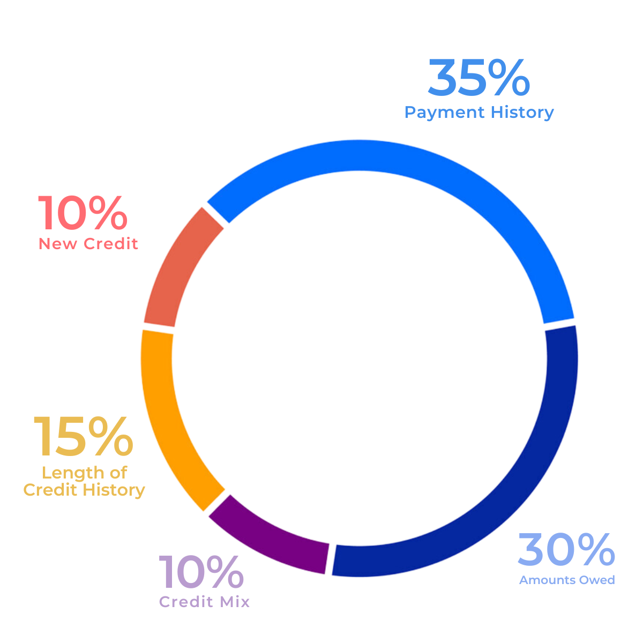
Indicators of Readiness
  Payment history: (35%) How well a person has paid their credit cards, loans, and other accounts.
  Amounts owed: (30%) The amount of debt a person has and the percentage of their available credit they're using.
  Length of credit history: (15%) How long a person has had credit and used it.
  New credit accounts: (10%) The number of new credit accounts a person has.
  Types of credit used: (10%) The types of credit a person has, also known as credit mix.
Notes:
Brand – FICO wheel. FICO = Fai Issac Corporation. A FICO credit score is a tool used by many lenders to determine if a person qualifies for a credit card, mortgage, or other loan.
Three Credit bureaus: Trans Union, Experian, and Equifax
Talking Points – CREDIT What is in your credit score?
Pay all bills on time
Pay down credit limits, but do not cancel.
Do not seek out credit before home purchase. Limit credit inquires
Do not close out any credit with out consulting your lender.

Slide 10
Indicators of Readiness
  Reality of impaired credit:
  You may be denied for a mortgage.
  Can lead to a higher interest rate, making your mortgage payments more expensive.
  May increase the costs of homeowners insurance and other insurances, like Private Mortgage Insurance.
  Long term financial stress.
Notes:
Talking Points

Slide 11
Indicators of Readiness
  Tip to rebuild your credit:
  Meet with a HUD approved housing counselor.
  Check your credit reports for errors.
  Free resources available at www.AnnualCreditReport.com
  Pay all your bills on time, for at least 24 months
  Reduce your credit card balances to no more than 30% utilization.
  Avoid opening new accounts in the year leading up to getting a mortgage.
Notes:
Talking Points
Mention Opt-Out Prescreen

Slide 12
What We Will Cover
Assessing Your Readiness
Build Your Team
Applying for a Mortgage and New Hampshire Housing
Finding Your Home and the Closing Process
Questions
Notes:
Talking Points – Any questions about assessing your readiness? Next up, lets talk about building your homeownership team.
Assessing your readiness for Homeownership
Your Homebuying Team
Applying for a mortgage and New Hampshire Housing Mortgage Programs
Finding your Home and the Closing Process
Questions

Slide 13

Build Your Team
Notes:
Overview of Your Homebuying Team

Slide 14
Build Your Team
Your Team:
Mortgage lender, buyer’s agent (Realtor®), home inspector, housing counselor, title company, appraiser and NH Housing.
Why a strong team matters:
Your team should guide and support you through every step of your homebuying journey.
Notes:
Talking Points
Explain the roles of each team member and how they can help you through your homeownership journey.
Mortgage Lender, housing counselor, real estate agent, home inspector, appraiser, closing agent
Provide and resources or tips on how to find team members.
Inform them on which members they can choose and which members the lender may choose (appraiser).
Tips for finding a lender/realtor:
Ask family for recommendations
Ask friends for recommendations
who did your friends use?
Read reviews
Interview your team
How long have you been doing this?
Are you full time or part-time
What areas do you serve
Can you provide referrals?
Look at their website/listings
Other important questions to ask your lender/realtor
Lender - Do you hold my mortgage, or will you sell it?
What are your fees?

Slide 15
Build Your Team
Housing Needs Assessment
Agent Meet-Up
Loan
Application
Lender
Pre-Approval
Lender Meet-Up
Find Your Home
Agent Meet-Up
Final Approval Lender
Conditional Approval
Lender
Home Inspection
Agent Meet-Up
Home Inspector
Pro tip: The standard mortgage process takes 30 – 45 days from contract to closing.
Closing!
Agent / Lender/ Title Company
Home
Notes:
Talking Points
Review mortgage process flow chart.

Slide 16

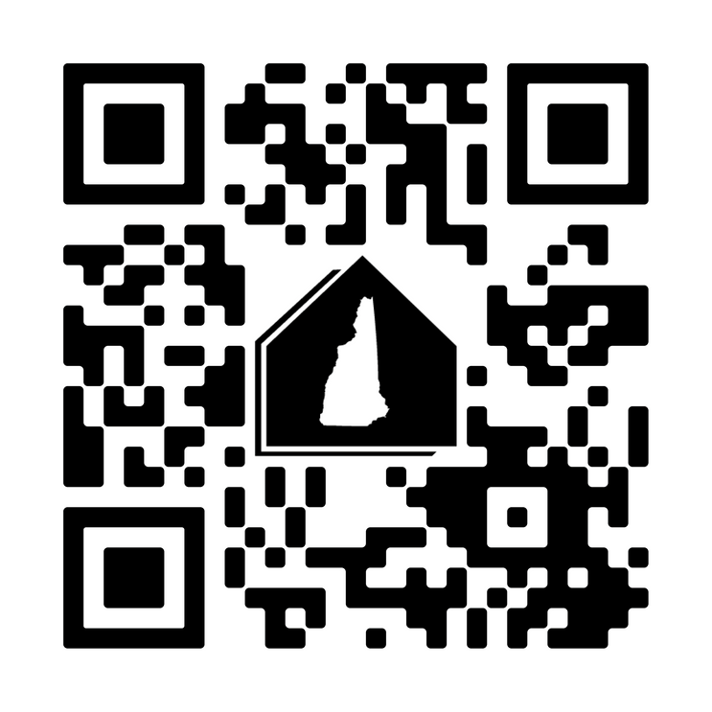
About New Hampshire Housing
  Max income $184,500
  Low downpayment options (zero to 3.5%)
  30-year fixed rates
  Both Government and conventional programs
  Downpayment Assistance - up to $15,000
  1st Generation homebuyer assistance - $10,000
  And more!
Check us out!
NHHousing.org
Notes:
Talking Points – Review benefits:
Explain the benefits of NH Housing mortgage programs
NH Housing’s website has search function capabilities to help you find your team!
https://www.nhhousing.org
All downpayment - All downpayment assistance is provided as a 0% APR, with no monthly payment required. Downpayment assistance must be paid back if you sell, refinance, no longer occupy the home or in 30 years.
1stGenHome - NH Housing offers 1stGen homebuyers additional assistance that can be combined with the other downpayment options! Buyers must meet the definition of 1stGen with NH Housing. Speak with an approved mortgage lender to see if your client qualifies!

Slide 17

About New Hampshire Housing
Downpayment assistance is provided as a 0% APR, 30-year term second mortgage with no monthly payment requirement.​ ​Payment is due when you sell, refinance, if it’s no longer your primary home or in 30 years.
Notes:
Talking Points
Review NH Housing’s Downpayment assistance programs:
2nd mortgage with a 30-year term. Due on sale, refinance, no longer owner occupied or in 30 years. You use NH Housing money for free!
Must have a NH Housing 1st Mortgage with NH Housing

Slide 18

About New Hampshire Housing
1stGenNH
$10,000 Dollars
NH Housing offers 1st Generation homebuyers additional assistance that can be combined with the other downpayment options! That means we could cover a total of $25,000 of their downpayment and closing costs when buying their first home! ​
​
Buyers must meet the NH Housing definition of 1stGen.
Notes:
Talking Points
Review 1st Gen Home NH program:
A first-generation homebuyer is defined as:
A borrower and co-borrower (if applicable) that do not currently, nor have previously, owned a home;
The borrower’s and co-borrower’s (if applicable) parent(s)/legal guardian(s) do not currently, nor have they previously, owned a home in the homebuyer’s lifetime;
A non-borrowing spouse (if applicable) does not currently, nor has previously, owned a home.
Additionally, a person meeting the following criteria also qualifies as a “first-generation homebuyer” - The borrower or co-borrower (if applicable) was in foster care or legally resides in the United States as a refugee or under asylum status granted by USCIS.
1st Generation Homebuyer Requirements
To take advantage of 1stGenHomeNH program you must be:
A first-generation homebuyer
Purchasing a single-family primary residence (1- 4 units) in NH.
Financing through one of our mortgage programs and using one of our Approved Lenders.
Complete face-to-face homebuyer education through either AHEAD, HOMEteam or the Housing Partnership.
1st Gen Downpayment assistance provided as a 2nd mortgage, 30-year term. Can be combined with any NH Housing program

Slide 19
What We Will Cover
Assessing Your Readiness
Build Your Team
Applying for a Mortgage and New Hampshire Housing
Finding Your Home and the Closing Process
Questions
Notes:
Talking Points – Any questions about assessing your readiness? Next up, lets talk about building your homeownership team.
Assessing your readiness for Homeownership
Your Homebuying Team
Applying for a mortgage and New Hampshire Housing Mortgage Programs
Finding your Home and the Closing Process
Questions

Slide 20

Applying for a Mortgage
Notes:
Transition to the mortgage application process.
Common issues:
CASH
“I’ll get it…”
A friend owes me money
Private Loans
Anything that can’t be documented
Trade
Interested Party Contributions
GIFTS
Must be a family member
Program specific
Employment
Is your job stable enough to maintain on time payments?
24-month employment history must be documented
Verification that it will continue for the next 3 years
Changing jobs in similar field and pay type
Other Employment Concerns?
Part time not consistent for 24 months
OT not consistent for 24 months
Seasonal work
Furloughed
Changing jobs from w2 to commission/self employed
Unexplainable gaps
Recent or Upcoming job change

Slide 21
Applying for Mortgage
Types of lenders:
Mortgage Lender
Mortgage Broker
Community Bank
Credit Union
Types of mortgages:
Government insured - FHA, USDA RD, VA
Conventional - Fannie Mae, Freddie Mac
Portfolio
Notes:
Talking Points
Quickly review the different types of mortgage programs and the benefits of each.
Explain PITI (Principal, interest, taxes and insurance)
Overview of mortgage Insurance – what it is and why
Introduce NH Housing’s mortgage programs:
Home Flex – Gov
Home Preferred – Conv
Home First – MRB
Maximum income $184,500
Minimum Credit score 620
Benefits of NH Housing programs:
Low downpayment requirements (3.5% to as low as zero)
Market favorable rates
No loan level price adjustments
Reduced mortgage insurance – for conventional product

Slide 22
Common Homebuying Question
Do I need 20% down to buy a home?
Programs like NH Housing offer low or no money down options!
Notes:
Talking Points
Review some common myths about homebuying.
Ask if there are other myths you need to address? Have them put their questions into the chat.
Talk about other myths

Slide 23
Applying for a Mortgage
Gather your document
  Must be complete, all pages
  PDFs preferred
Document needed, at a minimum:
  W-2s, most recent two years
  Paystub, most recent
  Bank statements, all pages, most recent two years
  Written explanation for any credit issues or concerns within the last two years
Pro Tip: Avoid changing jobs or making big purchases before closing!
Notes:
Talking Points
Add any other issues that may come up when qualifying for a mortgage.

Slide 24
Applying for a Mortgage – About Income
W-2 Income
This is a standard employment type, where you get paid by your employer via pay stub typically every other week. This type of income is typically averaged over 12 months.
1099 Income
For contractors, gig workers and self-employed people you will average a 24-month history of your 1099 Income. You will also likely need to produce your tax returns.
Schedule C
Self-employed people you will average a 24-month history of your business Income.
You will likely need to produce your tax returns for the last 24 months, or longer.
Notes:
Talking Points
Explain pre-qualified vs. Pre-approval.
Questions to ask yourself:
How much do you intend to use for downpayment and closing costs?
What accounts will you use for these funds?
Can a family member help with closing costs?
What do you do for a living?
How long have you been there?
Where did you work before?
Need a 2-year work history
What is your GROSS monthly income?
Are you fulltime or part time?
Are you hourly, salaried, or self employed?
Do you get commission? What %?
What was your prior year W-2 income?
What are your monthly obligations?
Installment
Revolving (use minimum payment)
Co-sign debt
Do you have any credit concerns?
Have you ever declared bankruptcy, foreclosed, or had a repossession?
What do you know about your credit?
Work with a professional to assess your first steps to improve your credit score
Experian Boost – other credit help tools
9

Slide 25
What We Will Cover
Assessing Your Readiness
Build Your Team
Applying for a Mortgage and New Hampshire Housing
Finding Your Home and the Closing Process
Questions
Notes:
Talking Points – Any questions about assessing your readiness? Next up, lets talk about building your homeownership team.
Assessing your readiness for Homeownership
Your Homebuying Team
Applying for a mortgage and New Hampshire Housing Mortgage Programs
Finding your Home and the Closing Process
Questions

Slide 26
Finding Your Home
Notes:
Transition to how to find your dream home.

Slide 27
Common Homebuying Question
Are there programs to help me rehab a home?
A rehab loan can help pay for necessary repairs and build equity!
Notes:
Talking Points
Review some common myths about homebuying.
NH Housing offers a purchase rehab program where you can roll up to $75k into your first mortgage to fix up your home. Safety and livability issues only. Must appraise for improvements. No structural improvements allowed.

Slide 28
Finding Your Home
Tips for house hunting:
Know your must-haves vs. nice-to-haves
Check out the neighborhood
Attend open houses and use online tools
Hire a buyer's agent
Get a home inspection
Pro Tip: Interview a few different Realtors before signing your buyer’s agreement! Your Realtor is your partner; have open communication and ensure you vibe!
Notes:
Talking Points
Provide tips on how to find a home
Any resources you may have – websites
Check out schools, crime, traffic
All real estate is location, location, location…
Read all Documentation!
If a condo – read budget, condo rules
Ded restrictions or covenants – understand what you are buying.
Get a Home Inspection! The appraiser will look at the market value, but they are not protecting you against maintenance issues or concerns. A home Inspector will educate you on the home and its systems. Attend the home inspection and ask questions.
Systems to look at:
Well, septic, roof, chimney, electric, heating, insulations, attic spaces, ventilation.
Lay of the land – where does water collect? Solar orientation – which way is south?

Slide 29

Closing Time!
What to Expect:
Attend a final walkthrough before signing
Review key documents (closing disclosure, deed, note)
Make sure IDs have not expired
Lots of paperwork – Don’t be afraid to ask questions
Celebrate – You made it!
Notes:
Talking Points
High overview of closing documents to be signed at closing.
Do a final walk through of the property before signing
If you do not understand something – ask questions before you sign.
Congratulations! You are a homeowner!

Slide 30



Common Homebuying Question
What if I am not ready to by a home?
Contact a HUD approved counseling agency for guidance!
Notes:
Talking Points
In NH there are three HUD approved counseling agencies ready to help you become mortgage ready. If you are not ready, reach out to one of them for homebuyer education and counseling!

Slide 31
QUESTIONS?
Notes:
Open discussion. How can we help you to be successful?
Ask for questions – take your self off mute or add them in the chat.

Slide 32
Thank You
Name
Title
Company
Tel:
Email:
Insert Headshot
Ryan Tufts
NMLS# 1639731
Tel: (603) 521-2160
Email: rtufts@TryNorthpoint.com
Notes:
Add your photo, NMLS# and your contact info. Don’t forget to add any accomplishments or designations. Top NH Housing lender???
Talking Points
Welcome, everyone! I’m thrilled you’re here, ready to learn about buying your first home. By joining today, you’re already taking an important step toward achieving the dream of homeownership! Together, we’ll explore how to build a strong financial foundation and shape the future you’ve always envisioned.
Introduce yourself. Include your Value Proposition, areas of town you specialize in, and even something personal about you / your team, for example, awards, charities, family, pets, hobbies, etc.
Talking Points
Let me tell you a little about myself.
My name is …
I’m with …
I’ve been doing this since …
and I have helped xx families buy their first home.
My passion is helping you get what you need when you need it!
I’m here to answer all your questions, so let’s dive in and get started on this exciting journey!

Slide 33
Learn More About New Hampshire Housing
  Affordable fixed-rate mortgages
  Downpayment assistance
  Low downpayment requirements
Check us out!
NHHousing.org
Notes:
QR code links to a NH Housing form that will provide homebuyers with information on the homebuying process and NH Housing programs.

